Slide 1
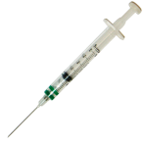

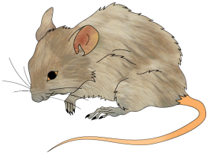
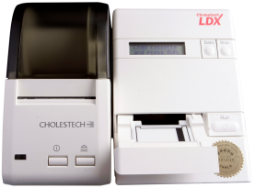

Measure Function
Process:
Collecting specimen from organism
is realized by
inheres in
Glucometer
Process:
Analyte assay
Glucose Measurement Datum
100 mg/dl
has specified input
has specified input
has specified output
has specified input
inheres in
has specified input
has specified output
inheres in
contained in
is realized by
Specimen Role
is realized by
is realized by
Analyte Role
Portion of Glucose
Blood Specimen
Evaluant Role
inheres in
part of
inheres in

Slide 2
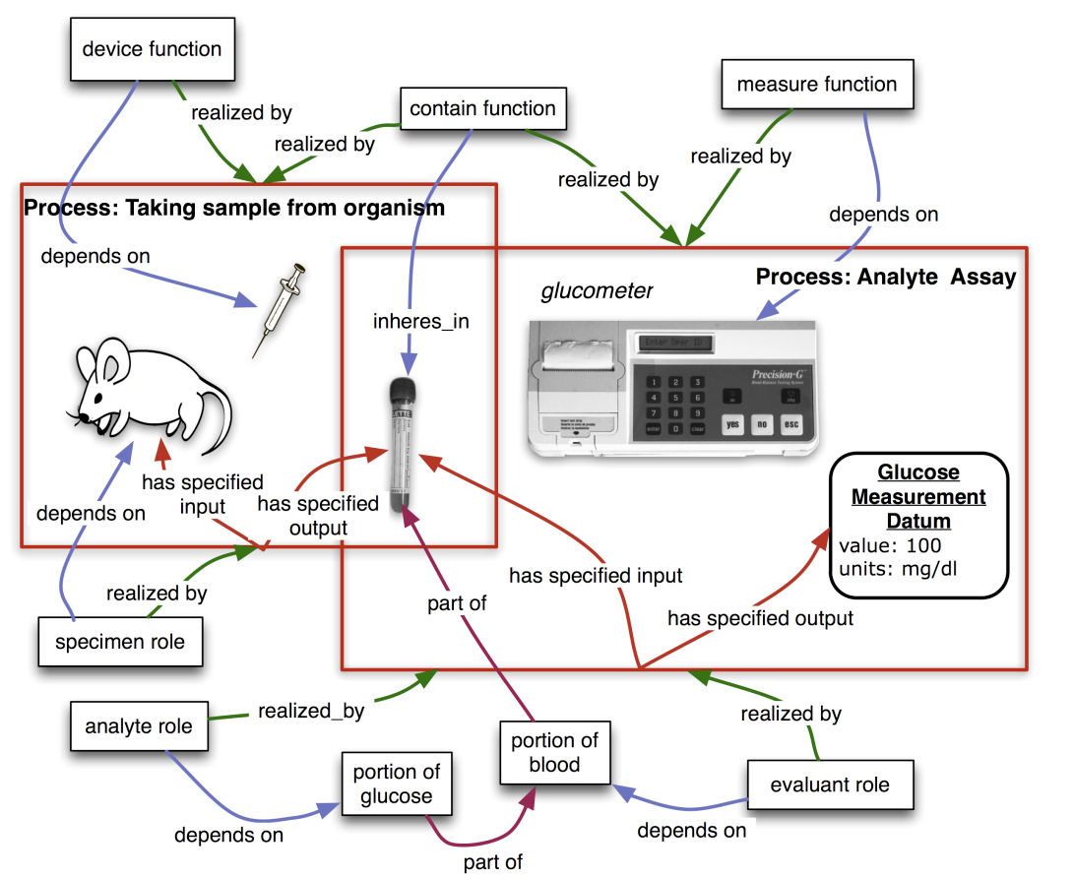

inheres in
inheres in
has
specified input
has
specified input
inheres in
inheres in
inheres in
inheres in

